Slide 1
Client Meeting 3/25/2026
System Architecture Discussion
Notes:
Today we’ll walk through our proposed system architecture for the AgWeatherNet AI chatbot
We’ll focus on how user queries flow through the system and how we can ensure accuracy and performance

Slide 2
Problem Overview
The problem we are solving:
AgWeatherNet provides valuable weather data, but it requires technical navigation and can be difficult for non-technical users to query data
Users (farmers, researchers) need quick insights and natural language to access data
The AgWeatherNet system lacks a conversational interface and intelligent query handling
Solution:
A proposed solution is developing a RAG-based pipeline for the AI chatbot
Key Flow: User → Chat UI → AI/LLM Processing → Retrieval/Logic → AgWeatherNet Database → Response → Chat UI → User

Slide 3
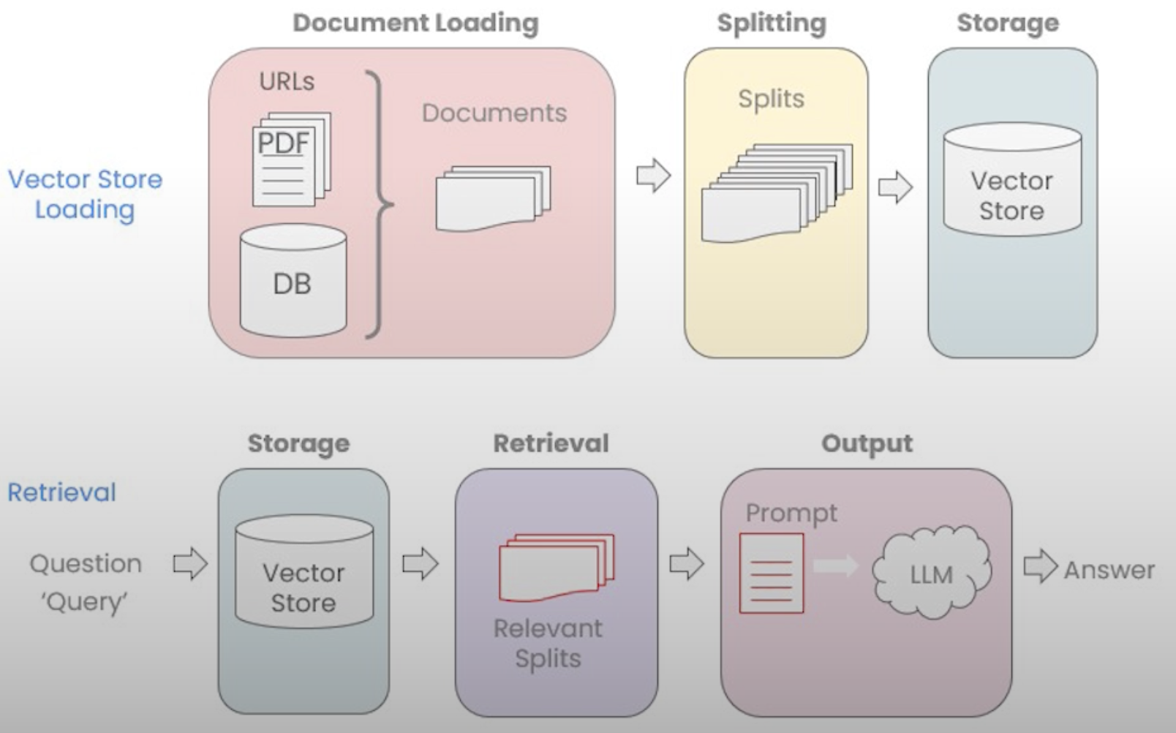
Proposed Solution: RAG Pipeline - Components
Embedding Model
Pipelines consist of many stages
Some steps require black box services
Ex: DBs, AI/LLM
see red items
Some steps will have custom implementation tailored to the problem
Document preprocessing
Data retrieval
Prompt templates
Vector DB
Client Facing LLM
Rag Pipeline - DeepLearning.AI, “Chat with your data” Course Overview

Slide 4
RAG Pipeline - Searching and Indexing Strategy
Semantic Search
Requires pre-processing and vector embedding step before storage in vector DB
Vector embedding represents the transformation of a data’s semantic meaning into a numerical form
Data with similar vectors/semantic reasoning are stored near each other for fast searches of related data
Versatile search that can handle both structured and unstructured data
Broadly used, meaning many tutorials and documentation available
Note: We spoke with Prof. Parteek about searching strategy and he says Semantic search will be best
Keyword Search (BM25 index)
Great for structured data
Minimal preprocessing required!
Commonly used in production
Only works for text data (keyword search)
Note: Hybrid search in RAG, generally refers to a combination of Semantic and Keyword search
Honorable mentions
LLM Generated SQL
LLM makes calls directly to DB
Metadata Filtering
Restrict search space by filtering out data based on metadata labels
Ex: Restricting search to a single weather station
Will likely still be used to assist semantic search!

Slide 5
RAG Pipeline - Embedding Model Component
Converts text into dense vectors that capture semantic meaning
Used to embed user questions, schema descriptions, field metadata, and example queries
Supports a semantic retrieval layer on top of structured AgWeatherNet data rather than replacing the database

Slide 6
RAG Pipeline - Embedding Model Component
Qwen3-Embedding-4B
Pros
Strongest retrieval quality for self hosted options
Large context window
Best retrieval capabilities
Cons
Higher computing costs
likely GPU-backed deployment for good performance
more infra complexity than smaller models
Rank: #5
Qwen3-Embedding-0.6B
Pros
lowest cost serious candidate among top realistic choices
long context support
lighter and easier to deploy than Qwen 4B
Cons
weaker retrieval quality than Jina and 4B
may trade off some retrieval quality for efficiency
Rank: #13
Jina-embeddings-v5-text-small
Pros
best balance of quality and deployment cost
much lighter than Qwen 4B
long context support
good practical first deployment option
Cost friendly
Cons
weaker than Qwen 4B on raw performance
Not the top performing model
Lower retrieval quality than 4B
Rank: #11

Slide 7
RAG Pipeline - Vector Store Component
PostgreSQL w/ PgVector
Pros
Self-hosted or Hosted, offered everywhere
Extension for PostgreSQL, so familiarity and lots of docs available
PostGreSQL is reliable and has been in production for decades
Cons
PostgreSQL was not built as vector DB first, so may have performance constraints at very high loads when compared to pure Vector DBs
pgvector is more basic, and is missing some conveniences like built in hybrid search (BM25 Keyword + vector search)
Hybrid search still possible
QDrant DB
Pros
Fully featured and pure Vector DB with many conveniences the main one being built in hybrid search
Cons
Only hosted/managed options available
Additional Notes:
There are other popular Vector DBs that compete with QDrant DB, all offer similar features and are restricted to managed options so they have been omitted. If you are interested in the managed only options we can look more into them.
Ex: Pinecone DB, Weavite, Milvus
Chroma DB
Pros
Self-hosted or Hosted
Incredibly simple setup and management
Cons
In memory DB
Does not support concurrent accesses
Single file, only scales vertically
Additional Notes:
A simple way to describe Chroma DB is its more or less the Vector DB equivalent of Sqlite, with similar benefits and drawbacks

Slide 8
RAG Pipeline - LLM Model Component
LLM Model choice → Impacts grounding reliability & hallucination risk
General self-hosting LLM model:
Pros:
Data never leaves your environment (no outside data)
No per-token API costs
Full control over stack and performance
Cons:
Requires hardware setup, configuration, and ongoing maintenance
Large models demand significant GPU/storage resources

Slide 9
RAG Pipeline - LLM Model Component
Llama 3.x (Meta)
Pros:
Best ecosystem support
8B model runs on modest hardware with strong performance
Strong instruction-following for grounding prompts
Cons:
Stronger general-world knowledge -> Higher risk of ignoring strict grounding
Larger variants need powerful GPUs
Gemma 3 (Google DeepMind)
Pros:
Best-in-class small model (4B is highly efficient)
Strong numerical/reasoning performance (Good for weather data)
Cons:
Not a true open-source license (May complicate fine-tuning)
Google-backed -> Trained on heavy general knowledge, some grounding risk
Qwen 2.5 (Alibaba)
Pros:
Best numerical reasoning (Does not hallucinate units)
Reliable structured/JSON output (Ideal for RAG pipelines)
Apache 2.0 license (Cleanest for commercial use)
Cons:
Smallest ecosystem
Alibaba-developed

Slide 10
LLM Hosting - Hardware Requirements
Predicting hardware requirements for LLM is complicated, but has several primary factors
Model Parameters, in billions, directly influences VRAM/RAM storage required
0.6B, 2B, 4B, 8B, …
Represents the computations model goes through to make decisions
On paper correlates with the models “smartness”
To compare, popular models (GPT/Claude) are likely measured in trillions of parameters, but their designs are top secret. For reference open source model Deepseek-R1 which competes with the large companies currently sits at 671B parameters
Quantization or “how the model parameters are stored and operated on”
Quantization is a solution used to allow LLMs to operate in restrained hardware environments
floating point parameters have higher accuracy but are more expensive to store(larger VRAM)
F16, F32 are originally used during model training
F16/F32 considered “unquantized”, it’s the original design and size
Integer quantization - storing model weights as integers can use less space
Q8 (8 bit int), Q4 (4 bit int) leads to roughly half and quarter size respectively
The trade off is reduced accuracy due to accumulated rounding error over time
Finding the sweet spot of speed and accuracy
Context size - The amount of tokens the LLM can consider at once
Can be thought of as the models “short term memory”
Directly influences required VRAM/RAM, but takes up much less space than the parameters…

Slide 11
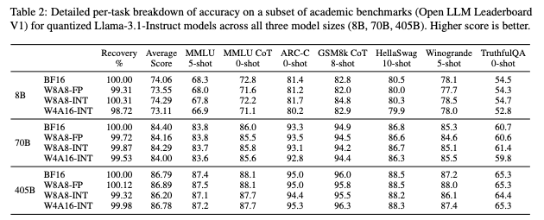
LLM Hosting - Hardware Requirements
Finding the sweet spot of quantization savings vs loss in performance
“Give Me BF16 or Give Me Death”? Accuracy-Performance Trade-Offs in LLM Quantization
Open LLM Leaderboard V1

Slide 12
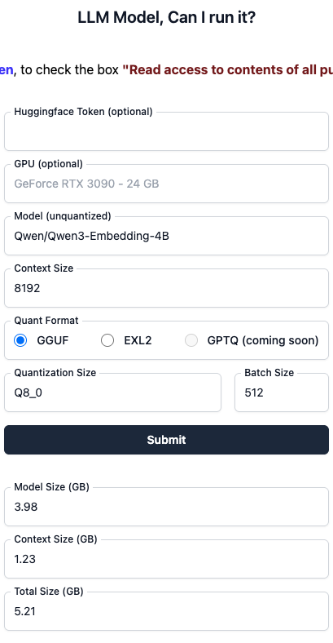
LLM Hosting - Hardware Requirements
HuggingFace LLM VRAM Calculator
Given a model, context size, and quantization
And other things (quant format, batch size, etc)
Estimate the total VRAM required to run the model
Roughly equal to:
(number of parameters * bytes/parameter) + (context size in number of tokens * bytes/token)
The technology is changing all the time, and there does not seem to be many standard forming
Common advice in forums and tutorials:
“Try and run it, if its too slow or you get Out-Of-Memory errors downsize quantization or number of parameters and try again.”
This plan can be assisted with container resource constraints during development

Slide 13
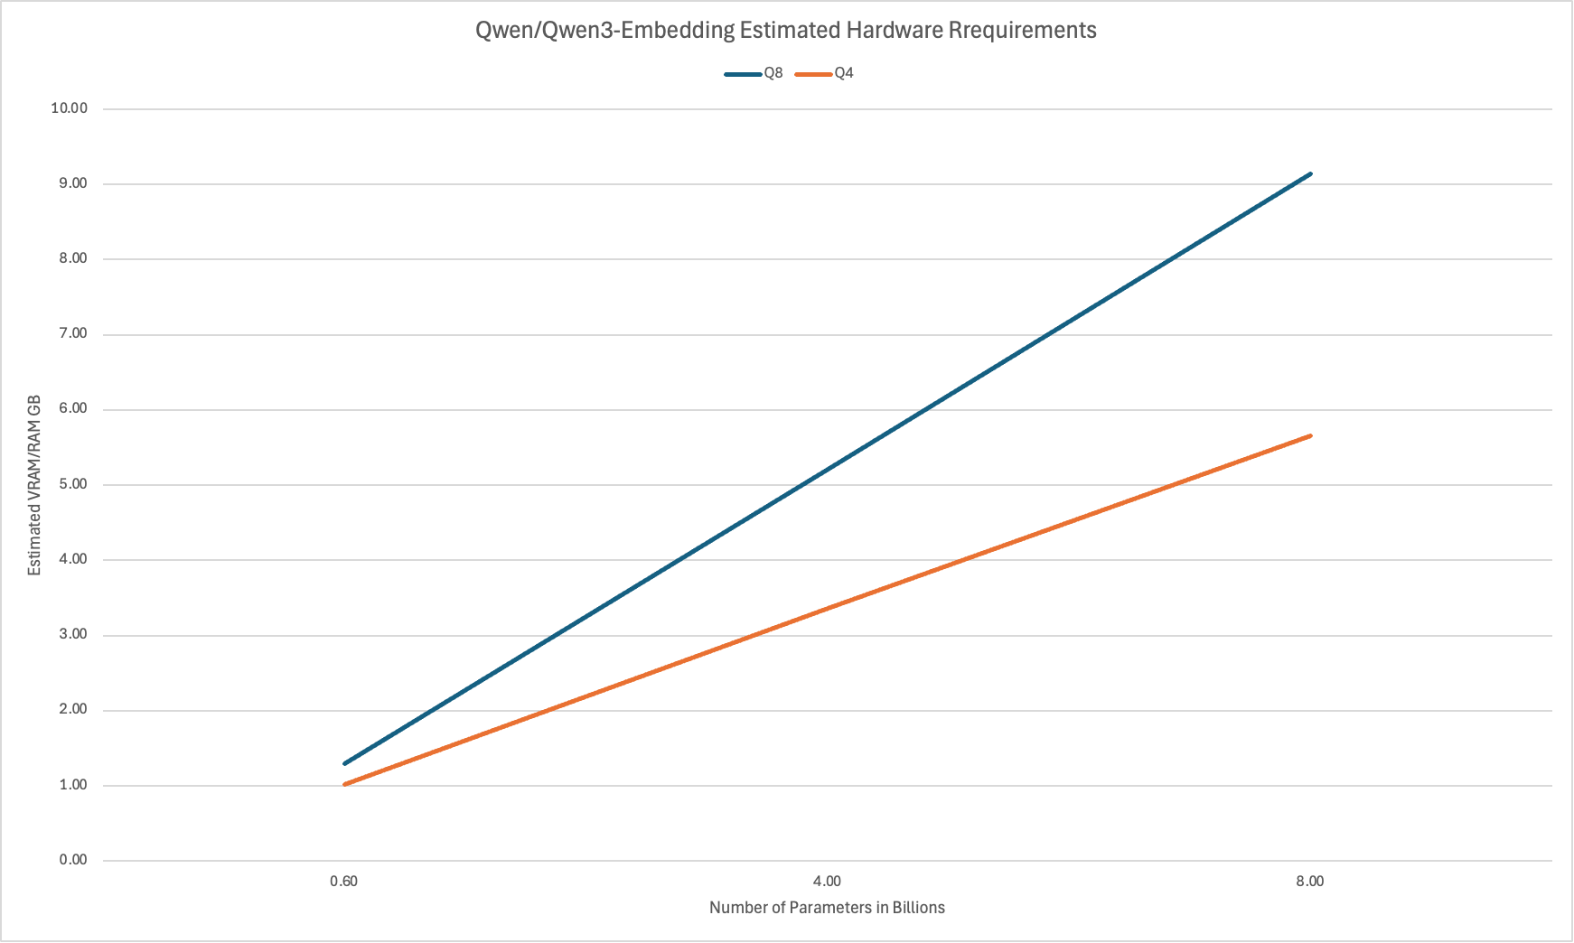
LLM Hosting - Hardware Requirements
Scales by number of parameters
Y-intercept is context size
Models tend to come in common sizes
Consumer sizes
2B
4B
8B
Enterprise sizes
35B
70B
397B
They grow fast..
Y = (parameter size * # of parameters) + context size

Slide 14
Questions for Client
What is an acceptable response time for queries?
Are there any constraints we should be aware of like cloud budget limits, that would affect which models we can realistically deploy?

